Slide 1


Git & GitHub

Slide 2
VCS –Version Control System
A category of software tools that helps in recording changes made to files by keeping a track of modifications done to the code.
Need for VCS
100 files developed for a project
Client suggested some changes
Changed some files source code to meet client requirement
Gave the demo and client suggested some more changes
Changed some files source code to meet client requirement
Gave demo third time
Client asked for 1st version only
We need to maintain every new version of our code! We can do this using VCS.

Slide 3
Benefits of VCS:
We can maintain different versions and we can choose any version based on client requirement.
With every version/commit we can maintain metadata like
1. commit message
2. who did changes
3. when he did the change
4. what changes he did
Developers can share the code to the other developers in very easy way.
Multiple developers can work in collaborative way
Parallel development is easy
We can provide access control like
1. who can read code
2. who can modify code

Slide 4
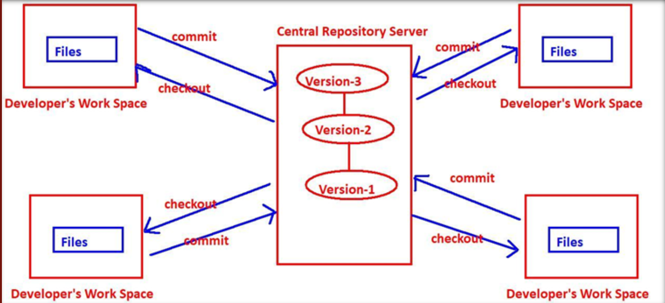
Types of VCS:
Centralized Version Control System:
- It has one central repository for all developers

Slide 5
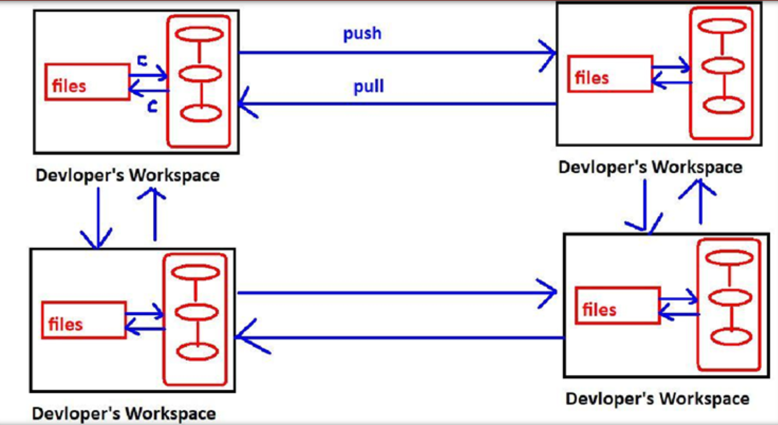
2. Distributed Version Control System:
- If 4 developers are there then 4 repositories will be there.

Slide 6
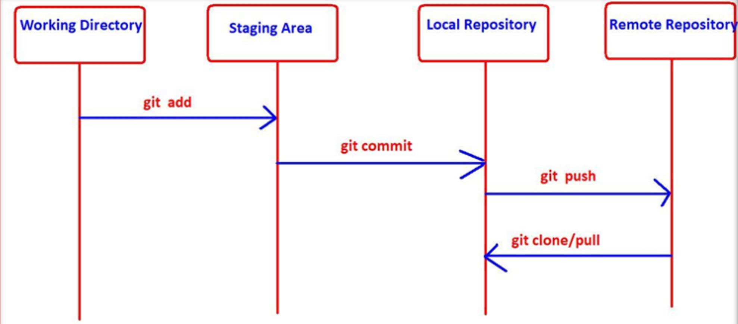
What is GIT?
Git is distributed version control system.
Most of the companies like Microsoft, Facebook, Yahoo, Linkedin, Intel using Git as version control system.
GIT Architecture:

Slide 7
What is Branching?
Git branching allows developers to diverge from the production version of code to fix a bug or add a feature.
Branch naming strategies:
username/description
username/work-item
bugfix/description
feature/feature-name
hotfix/description
Advantages of Branching:
We can enable parallel development.
We can work on multiple flows in isolated way.
We can organize source code in clean way.
Implementing new features will become easy.
Bug fixing will become easy.
Testing new ideas or new technologies will become easy.

Slide 8
What is GitHub?
GitHub is a website and cloud-based service that provides code hosting platform for version control and collaboration.
GitHub’s interface is user-friendly enough, so anyone can take advantage of Git.
Without GitHub, using Git generally requires a bit more technical savvy and use of the command line.

